Slide 1
White Box Testing
SQE Presentation

Slide 2
Group Members
Najam Mushtaq
Sana Iqbal Saney
M Abdullah
Moiz khan
Sundas Waris

Slide 3
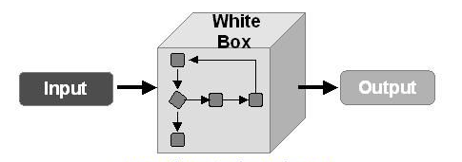
What is White Box Testing?
White box testing is a software testing technique that involves testing the internal structure and workings of a software application.
The tester has access to the source code and uses this knowledge to design test cases.
These test cases verify the correctness of the software at the code level.

Slide 4
What is White Box Testing? Cont..
White box testing is also known as Structural Testing and Code-based Testing.
It is used to test the software’s internal logic, flow and structure.

Slide 5


Slide 6
What Does White Box Testing Focus On?
White Box testing allows testers to create detailed test cases based on the application’s design and functionality.
Here are some key types of tests commonly used in white box testing:
Path Testing: Verifies all possible execution paths to ensure correct and efficient program behavior.

Slide 7
What Does White Box Testing Focus On? Cont..
Security Testing: Identifies security vulnerabilities in code using tools like static analysis to ensure safe development practices.
Loop Testing: Checks that loops function correctly, efficiently, and without logical or infinite errors.
Data Flow Testing: Ensures variables are correctly declared, initialized, and used to avoid data handling issues.

Slide 8

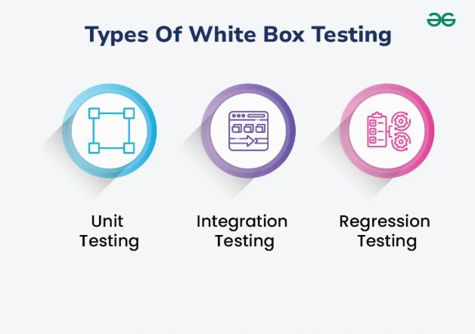

Slide 9
Types Of White Box Testing
White box testing can be done for different purposes at different places. There are three main types of White Box testing which is follows:-
Unit Testing: Unit Testing checks if each part or function of the application works correctly.
Example: Checking if a login function returns correct output when given valid or invalid credentials.

Slide 10
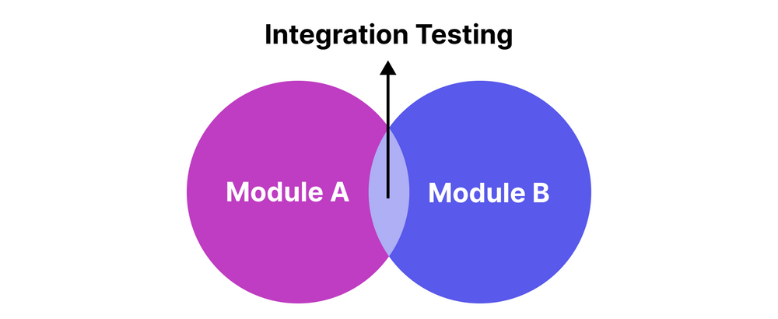
Types Of White Box Testing Cont..
Integration Testing: Integration Testing Examines how different parts of the application work together.
After unit testing to make sure components work well both alone and together.
Example: Ensuring the login function works with the database and redirects correctly.

Slide 11

Types Of White Box Testing Cont..
Regression Testing: Regression Testing Verifies that changes or updates don’t break existing functionality of the code.
It will check the application still passes all existing tests after updates.
Example: After adding a new feature like "Forgot Password" to the login page, regression testing checks that the original login function (with valid/invalid credentials) still works correctly and hasn’t been broken by the new update.

Slide 12


Slide 13
White Box Testing Techniques
To achieve complete code coverage, white box testing uses the following techniques:
1. Statement Coverage: In this technique, the aim is to traverse all statements at least once. Hence, each line of code is tested. In the case of a flowchart, every node must be traversed at least once. Since all lines of code are covered, it helps in pointing out faulty code.
Goal: Make sure every line of code runs at least once.

Slide 14
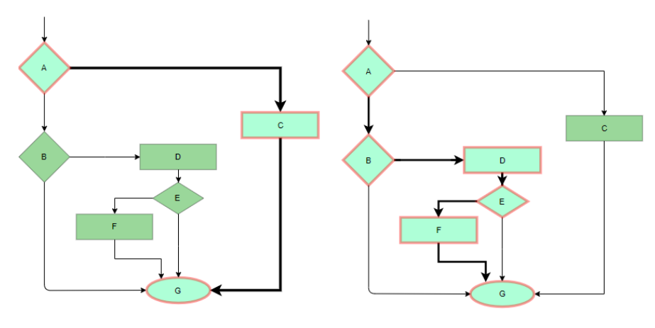
White Box Testing Techniques Cont..
Example 1:
a = 5, b = 10
c = a + b
print(c)
One test case is enough to cover all statements.
Example 2:
x = 5
if x > 0:
print("Positive")
print("Done")
Use x = 5 to cover all three lines (if Positive and Done print).

Slide 15
White Box Testing Techniques Cont..
2. Branch Coverage: Branch coverage focuses on testing the decision points or conditional branches in the code.
It checks whether both possible outcomes (true and false) of each conditional statement are tested.
In a flowchart, all edges must be traversed at least once.
Goal: Test every branch of decision points (like both True and False cases in an if).

Slide 16
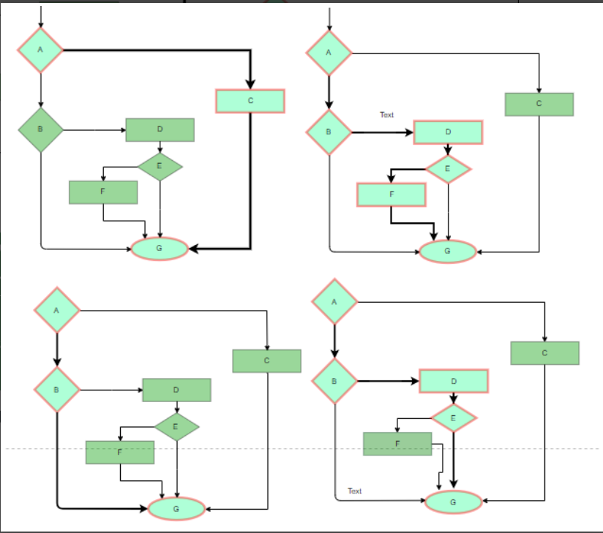
White Box Testing Techniques Cont..
Example 1:
if age >= 18:
print("Adult")
else:
print("Minor")
Test Cases:
age = 20 (True branch)
age = 16 (False branch)
Example 2:
if x == 0 or y == 0:
print("Zero found")
Test Cases :
x = 0, y = 5 (True)
x = 5, y = 5 (False)

Slide 17
White Box Testing Techniques Cont..
3.Condition Coverage: In this technique, all individual conditions must be covered as shown in the examples ahead:
Goal: Test each individual condition inside complex decision points.

Slide 18
White Box Testing Techniques Cont..
Example 2:
if x == 0 or y == 0:
print("At least one zero")
Test cases:
x = 0, y = 55
x = 5, y = 0
Example 1:
if A > 0 and B > 0:
print("Both Positive")
Test cases:
A = 5, B = -1 (Tests A True, B False)
A = -1, B = 5 (Tests A False, B True)

Slide 19
White Box Testing Techniques Cont..
4. Multiple Condition Coverage: In this technique, all the possible combinations of the possible outcomes of conditions are tested at least once.
Goal: Test all possible combinations of condition outcomes (True/False).

Slide 20
White Box Testing Techniques Cont..
Example 1:
if x == 0 or y == 0:
print("Zero found")
Test cases:
x = 0, y = 0
x = 0, y = 5
x = 5, y = 0
x = 5, y = 5
Example 2:
if A > 0 and B > 0:
print("Both Positive")
Test cases:
A = 1, B = 1
A = 1, B = -1
A = -1, B = 1
A = -1, B = -1

Slide 21
White Box Testing Techniques Cont..
5. Basis Path Testing: In this technique, control flow graphs are made from code or flowchart and then Cyclomatic complexity is calculated which defines the number of independent paths so that the minimal number of test cases can be designed for each independent path.
Steps:
Make the corresponding control flow graph
Calculate the cyclomatic complexity
Find the independent paths
Design test cases corresponding to each independent path

Slide 22
White Box Testing Techniques Cont..
Cyclomatic complexity formulas:
V(G) = P + 1, where P is the number of predicate(decision) nodes in the flow graph
V(G) = E – N + 2, where E is the number of edges and N is the total number of nodes
Goal:
To test all possible independent logical paths through test cases at least once.

Slide 23
White Box Testing Techniques Cont..
Example 1
Code:
1. Start
2. if A > 0:
3. if B > 0:
4. print("Both A and B are positive")
5. else:
6. print("A is positive but B is not")
7. else:
8. print("A is not positive")
9. End
Step 1: Draw the Control Flow Graph (CFG)
[1]
|
[2]----> No ---> [8]
|
Yes
|
[3]----> No ---> [6]
|
Yes
|
[4]
|
[9]

Slide 24
White Box Testing Techniques Cont..
Control Flow Graph (CFG)
[1]
|
[2]----> No ---> [8]
|
Yes
|
[3]----> No ---> [6]
|
Yes
|
[4]
|
[9]
Step 2: Count Nodes (N) and Edges (E)
Nodes (N): 7 (1, 2, 3, 4, 6, 8, 9)
Edges (E): 8 (1→2, 2→3, 2→8, 3→4, 3→6, 4→9, 6→9, 8→9)
Step 3: Calculate Cyclomatic Complexity (V(G))
Using both formulas:
V(G) = E - N + 2 = 8 - 7 + 2 = 3
V(G) = P + 1 = 2 + 1 = 3 (2 decision nodes: if A > 0, if B > 0) So, Cyclomatic Complexity = 3

Slide 25
White Box Testing Techniques Cont..
Step 4: Identify Independent Paths
We need 3 test cases to cover these 3 paths:
Path 1: 1 → 2 (Yes) → 3 (Yes) → 4 → 9 Both A and B are positive
Path 2: 1 → 2 (Yes) → 3 (No) → 6 → 9 A positive, B not
Path 3: 1 → 2 (No) → 8 → 9 A is not positive
Control Flow Graph (CFG)
[1]
|
[2]----> No ---> [8]
|
Yes
|
[3]----> No ---> [6]
|
Yes
|
[4]
|
[9]

Slide 26
White Box Testing Techniques Cont..
Independent Paths
Path 1: 1 → 2 (Yes) → 3 (Yes) → 4 → 9 Both A and B are positive
Path 2: 1 → 2 (Yes) → 3 (No) → 6 → 9 A positive, B not
Path 3: 1 → 2 (No) → 8 → 9 A is not positive
TC# | A | B | Output | Path
TC1 | 5 | 7 | "Both A and B are positive" | P1
TC2 | 5 | -2 | "A is positive but B is not" | P2
TC3 | -4 | any | "A is not positive" | P3
Step 5: Design Test Cases

Slide 27
White Box Testing Techniques Cont..
Paths:
password is "abc"
password is not "abc"
Test Cases:
Password = “abc” (Valid)
Password = “123” (Invalid)
Example 2:
Code:
if password = = "abc":
print("Access granted")
else:
print("Try again")
Cyclomatic Complexity = 2

Slide 28
White Box Testing Techniques Cont..
6. Loop Testing: Loops are widely used and these are fundamental to many algorithms hence, their testing is very important.
Simple loops: For simple loops of size n, test cases are designed that:
Skip the loop entirely
Only one pass through the loop
2 passes
n passes
n-1 and n+1 passes

Slide 29
White Box Testing Techniques Cont..
Nested loops: For nested loops, all the loops are set to their minimum count, and we start from the innermost loop. Simple loop tests are conducted for the innermost loop and this is worked outwards till all the loops have been tested.
Concatenated loops: Independent loops, one after another. Simple loop tests are applied for each.

Slide 30
White Box Testing Techniques Cont..
Test Cases:
Example 1: Simple Loop
for i in range(n):
print(i)
TC# | n | Expected Behavior
TC1 | 0 | Loop skipped entirely
TC2 | 1 | Loop runs once
TC3 | 2 | Loop runs twice
TC4 | 4 | Normal run (less than max)
TC5 | 5 | Loop runs n times
TC6 | 6 | Loop runs one extra time (n+1 check)

Slide 31
White Box Testing Techniques Cont..
Test combinations:
i = 0, j = 0
i = 0, j = 1
i = 1, j = 0
i = 1, j = 1
Example 2: Nested Loop
for i in range(2): # Outer loop
for j in range(2): # Inner loop
print(i, j)
How to test:
Start with minimum value for i and j (0)

Slide 32


Slide 33
Advantages of White Box Testing
Thorough Testing: White box testing is thorough as the entire code and structures are tested.
Code Optimization: It results in the optimization of code removing errors and helps in removing extra lines of code.
Early Detection of Defects: It can start at an earlier stage as it doesn’t require any interface as in the case of black box testing.

Slide 34
Advantages of White Box Testing Cont..
Detection of Complex Defects: Testers can identify defects that cannot be detected through other testing techniques.
Comprehensive Test Cases: Testers can create more comprehensive and effective test cases that cover all code paths.

Slide 35


Slide 36
Disadvantages of White Box Testing
Programming Knowledge and Source Code Access: Testers need to have programming knowledge and access to the source code to perform tests.
Overemphasis on Internal Workings: Testers may focus too much on the internal workings of the software and may miss external issues.
Dependency on Tester Expertise: Testers are required to have in-depth knowledge of the code and programming language as opposed to black-box testing.
Inability to Detect Missing Functionalities: Missing functionalities cannot be detected as the code that exists is tested.

Slide 37


